Slide 1

Computationally Modeling Reasoning
Professor John Licato
University of South Florida
First-Order Logic

Slide 2
Quantifiers
Transform ZOL into FOL
Here we’ll only use two first-order quantifiers
They are called this because they quantify over objects (not predicates or anything else)
Universal (FORALL) and Existential (EXISTS)

Slide 3
Universal Quantifier
Socrates is a man. All men are mortal. ---- Therefore, Socrates is mortal.
isMan(Socrates)
∀_{x} isMan(x) → isMortal(x)
isMortal(Socrates)

Slide 4
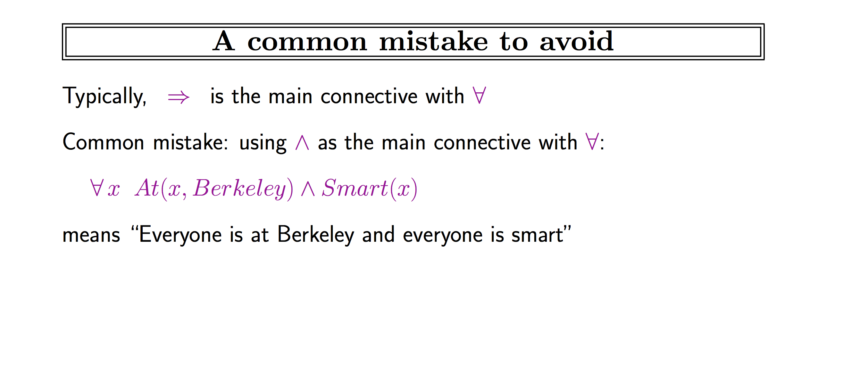
This slide is from Stuart Russell’s AIMA course slides: http://aima.eecs.berkeley.edu/slides-pdf/

Slide 5
Existential Quantifier
There is at least one man.
All men are mortal. ---- Therefore, there is at least one mortal.
∃_{x} isMan(x)
∀_{x} isMan(x) → isMortal(x)
∃_{x} isMortal(x)

Slide 6
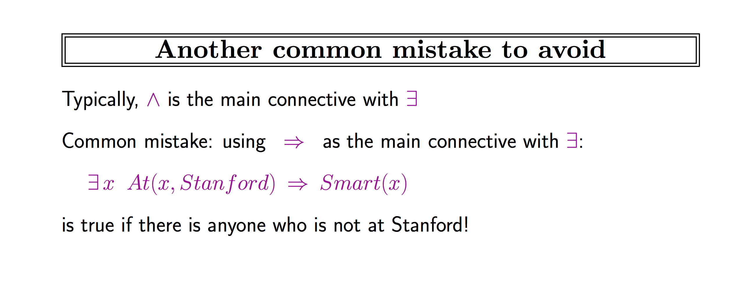
This slide is from Stuart Russell’s AIMA course slides: http://aima.eecs.berkeley.edu/slides-pdf/

Slide 7
We’ll normally use a,b,c,… to refer to objects
We use x,y,z to refer to quantified variables
A single quantifier quantifies over exactly one variable---no more, no less (unless otherwise stated)
The quantifier has a scope which can only be superceded by more deeply nested quantifiers
The order of operations is not consistently defined---always be clear about which standard is expected!
OK: NOT OK (why?):
<< (Sometimes we’ll use this as shorthand)
Notes:
&\forall_x P(x)\\
&\forall_x P(x) \wedge Q(x)\\
&\exists_x P(x) \rightarrow \exists_x Q(x)\\
&P(x) \wedge \forall_y P(a)
&\exists_x \exists_x \exists_y P(x,y) \wedge Q(x)\\
&\forall_{x,y} R(x,y)\\
&\forall_P P(x)

Slide 8
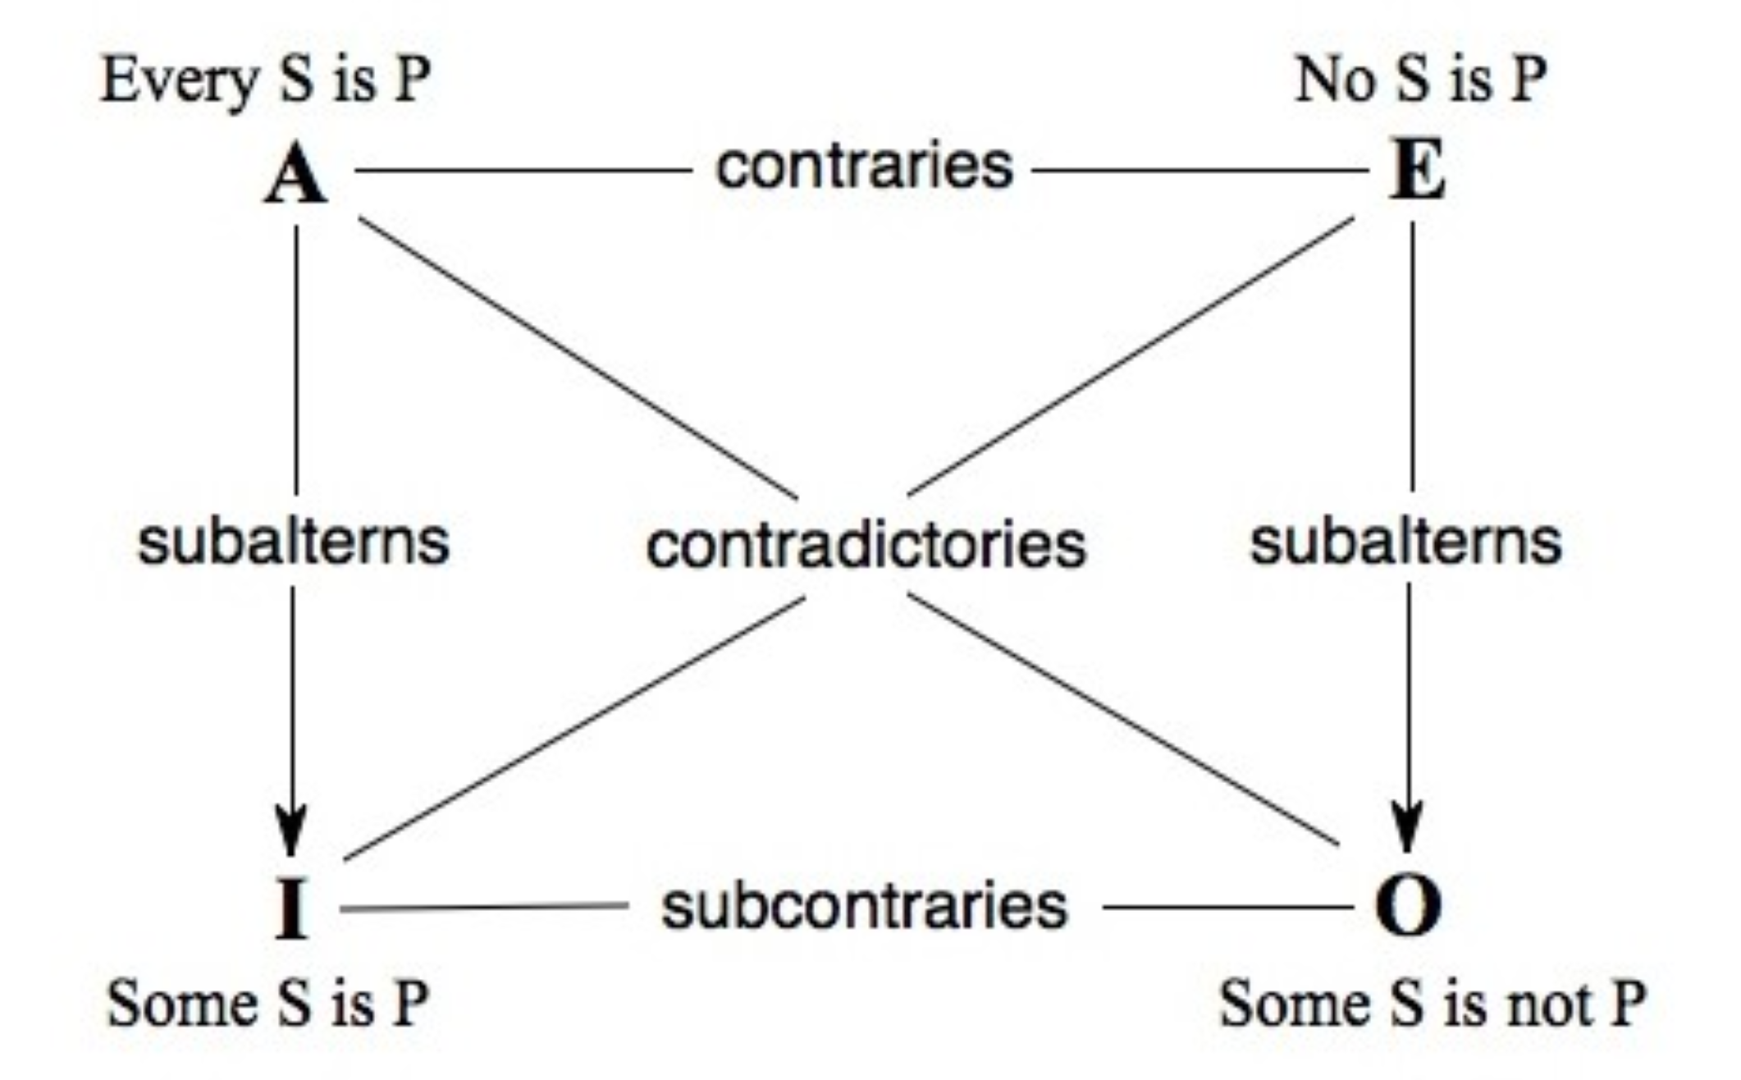
Aristotelian Square of Opposition
Source: https://plato.stanford.edu/entries/square/
Notes:
&\mathbf{A:} \forall_x S(x) \rightarrow P(x)\\
&\mathbf{E:} \forall_x S(x) \rightarrow \neg P(x)\\
&\mathbf{I:} \exists_x S(x) \wedge P(x)\\
&\mathbf{O:} \exists_x S(x) \wedge P(x)

Slide 9


Ambiguity in NL
“Every girl is loved by a boy”
Formalizing helps us be clear about which interpretation is meant!

Slide 10
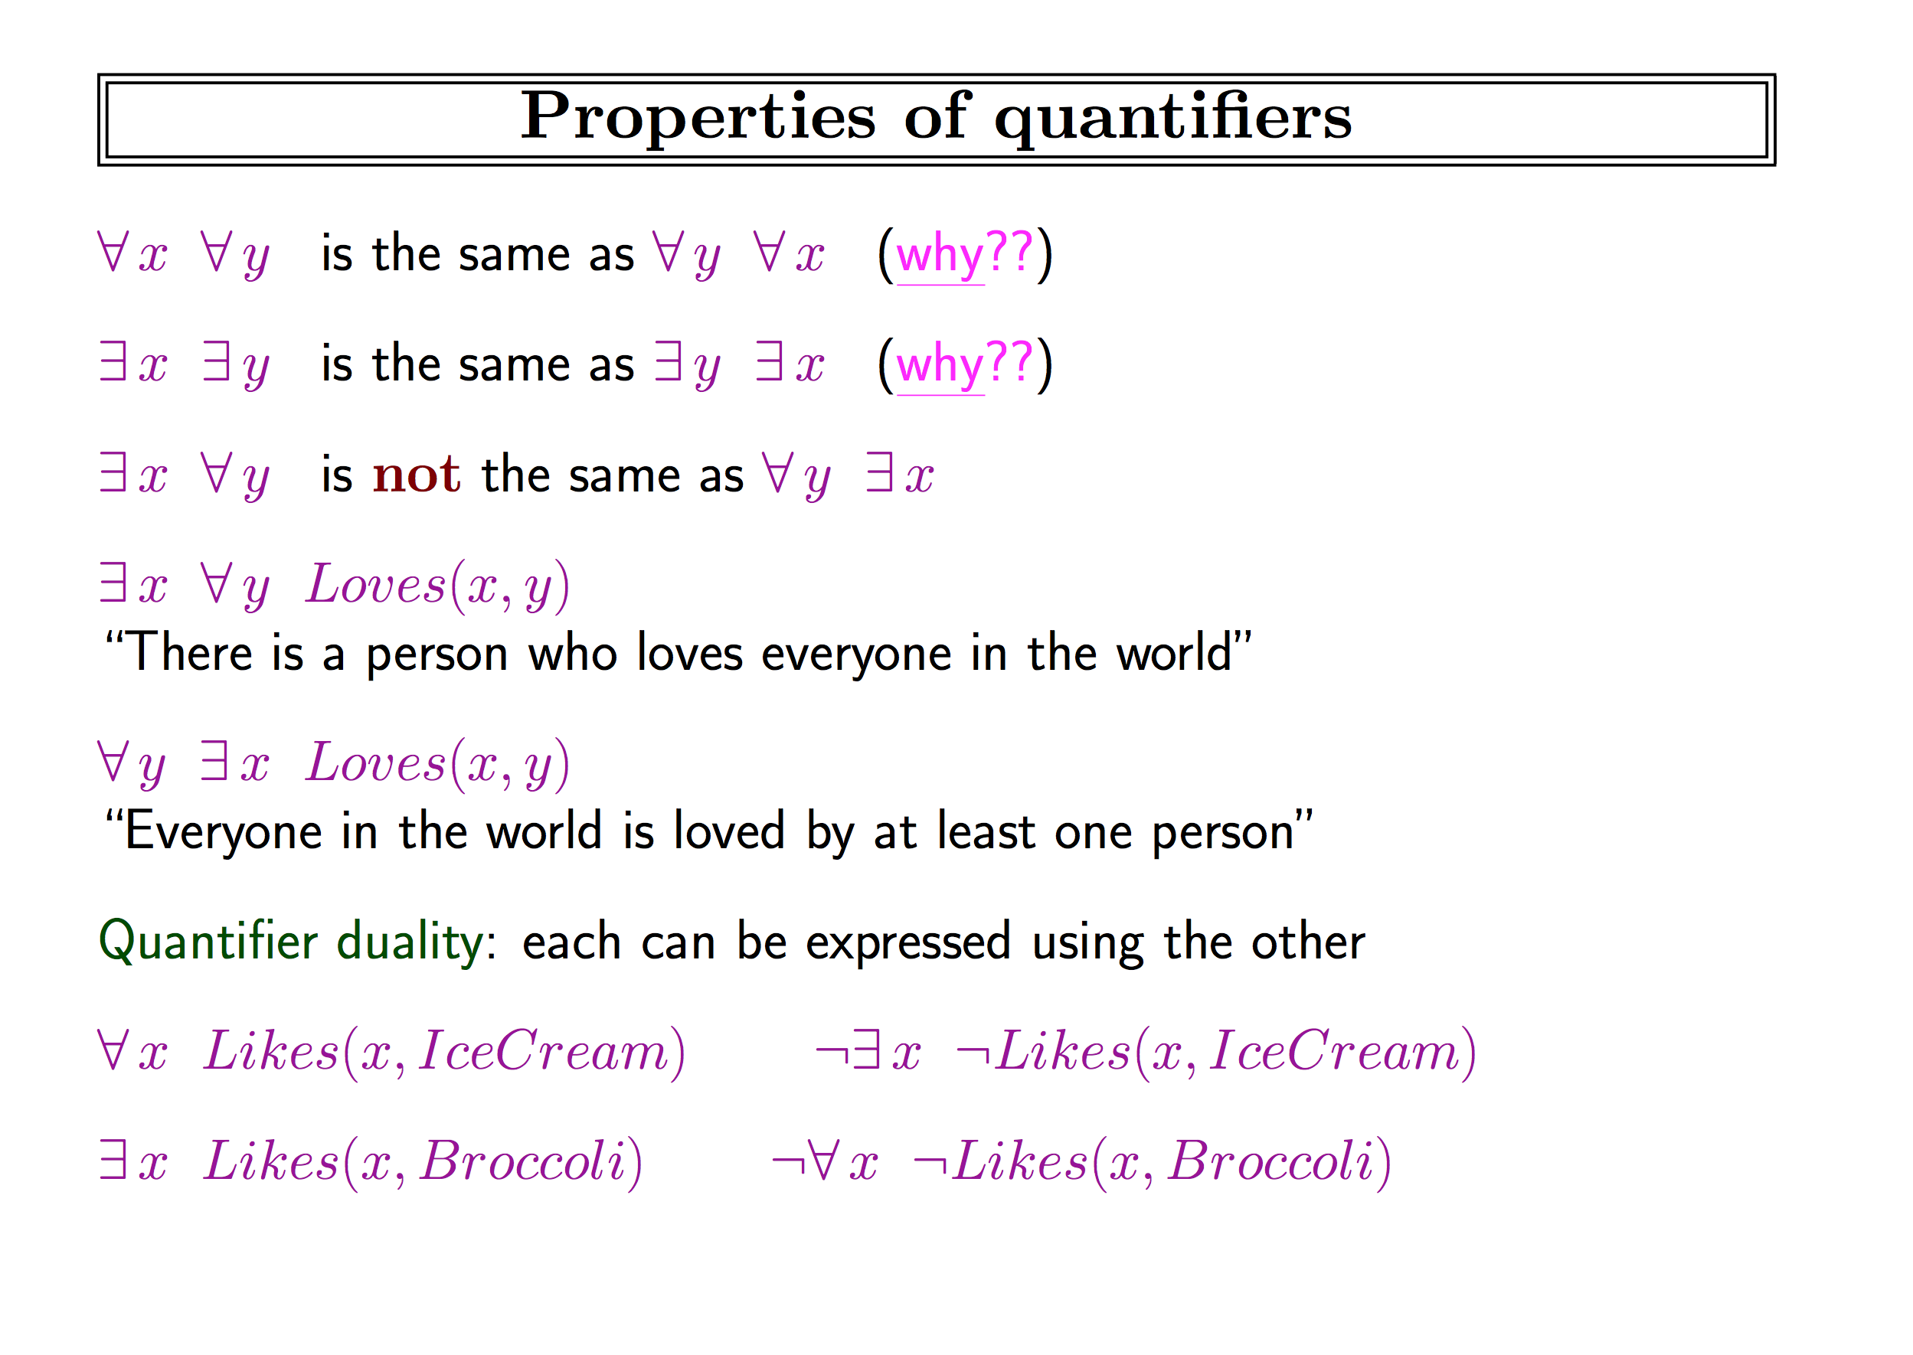
This slide is from Stuart Russell’s AIMA course slides: http://aima.eecs.berkeley.edu/slides-pdf/

Slide 11
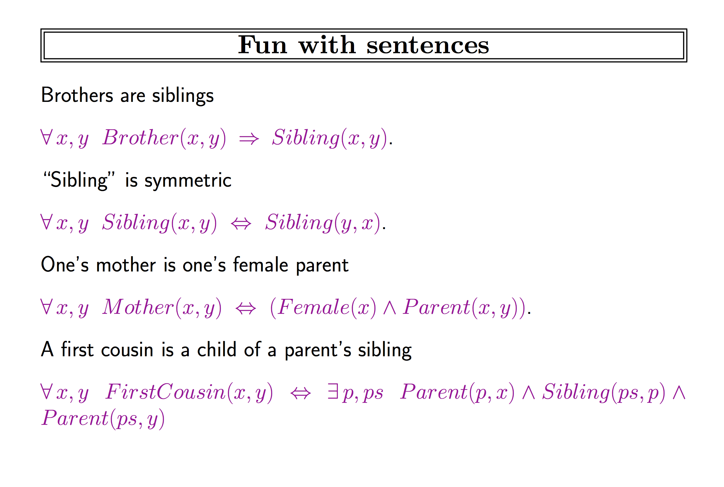
someone solve this
someone solve this
someone solve this
someone solve this

Slide 12
How would you formalize tic-tac-toe in FOL?
s1 s2 s3
s4 s5 s6
s7 s8 s9
Step 1: Define the objects/constants
= true when square x is directly to the right of square y
Step 2: Define the predicates
= true when square x is directly to the left of square y
= true when square x has an X, O, or is empty, respectively

Slide 13
Step 3: Create axioms (statements that are always true)

Slide 14
0-place predicate!
?
?
?
Notes:
diagonalVictory \leftrightarrow \exists_{x,y,z} (&(isX(x) \wedge isX(y) \wedge isX(z) \wedge below(y,x) \wedge below(z,y)) \vee\\
&(isO(x) \wedge isO(y) \wedge isO(z) \wedge below(y,z) \wedge below(z,y)))

Slide 15
8.23) Are these good FOL formalizations? If not, correct them.
No two people have the same social security number.
John’s social security number is the same as Mary’s.
Everyone’s social security number has nine digits.

Slide 16
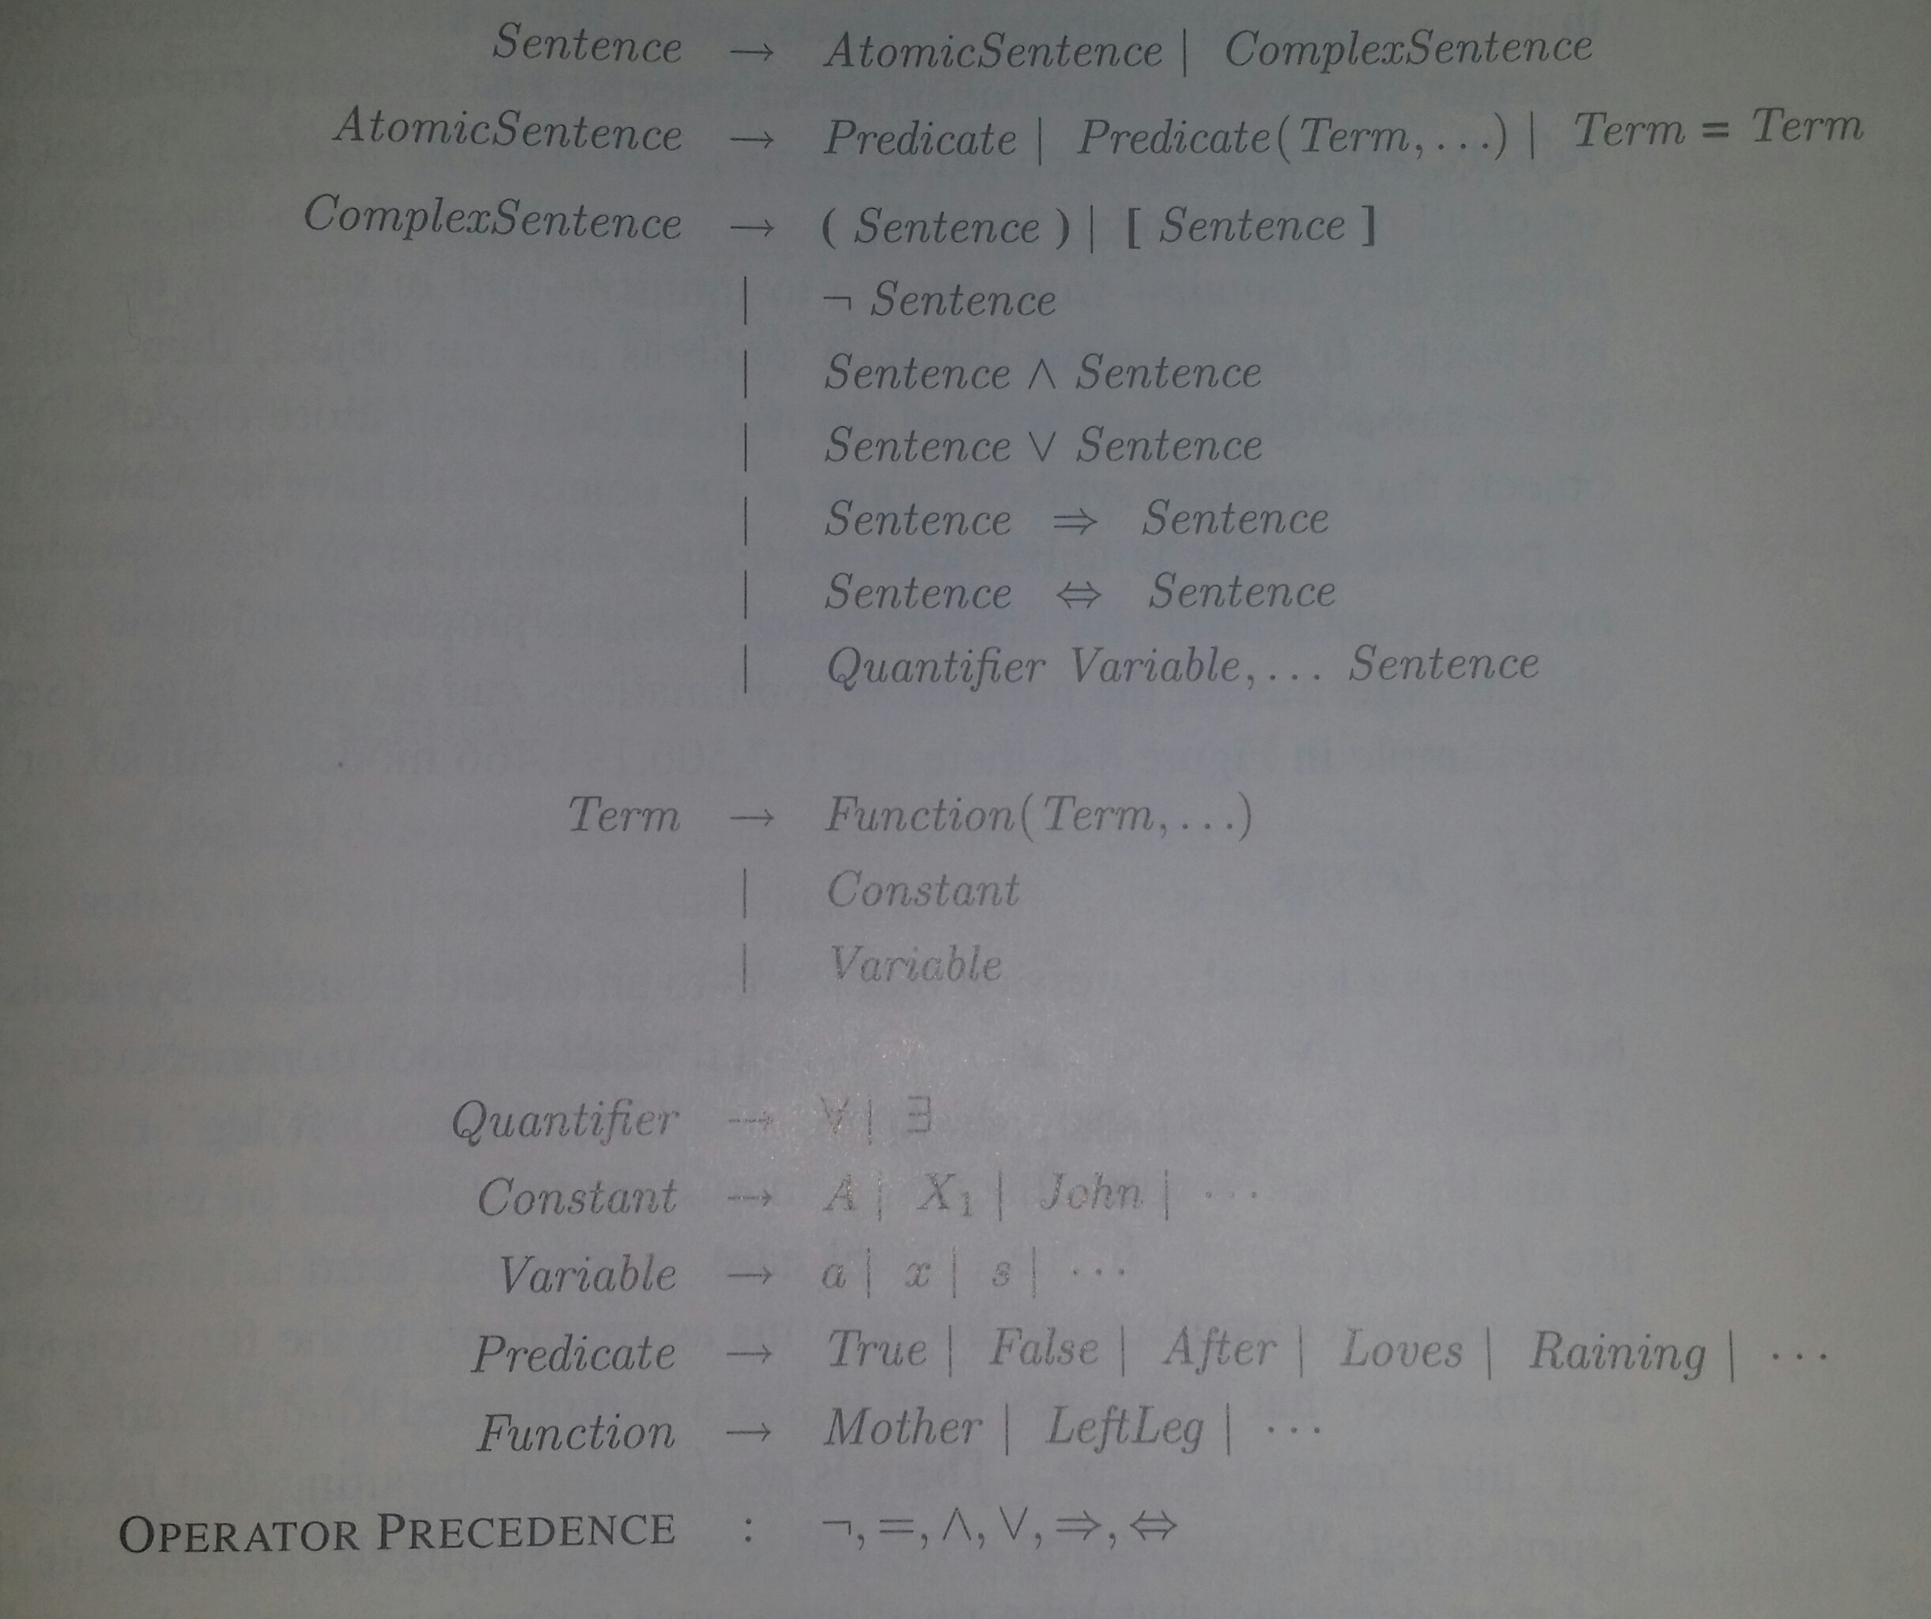
Difference between predicates and functions?

Slide 17
Fitch-style FOL rules
Many of the following slides are from Dr. William Starr, http://williamstarr.net/teaching/2310/

Slide 18
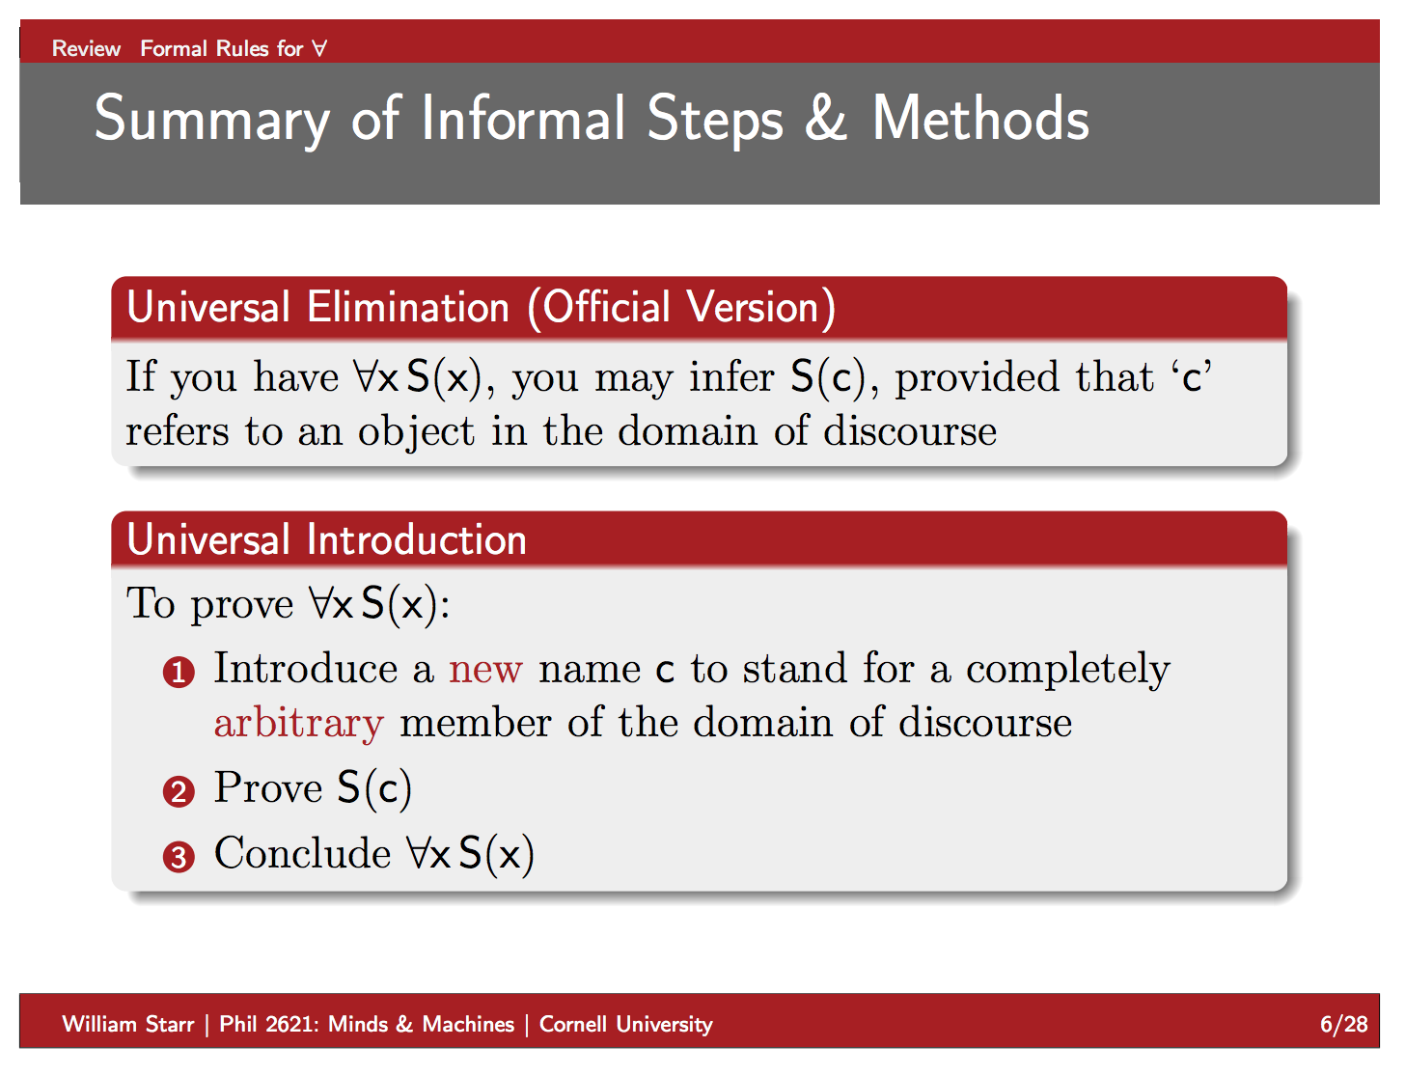

Slide 19
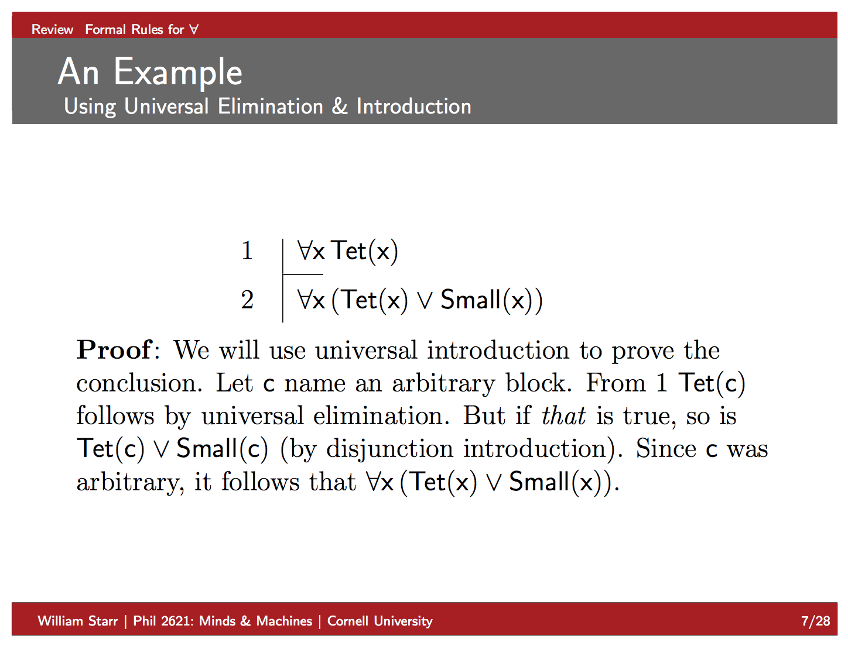

Slide 20
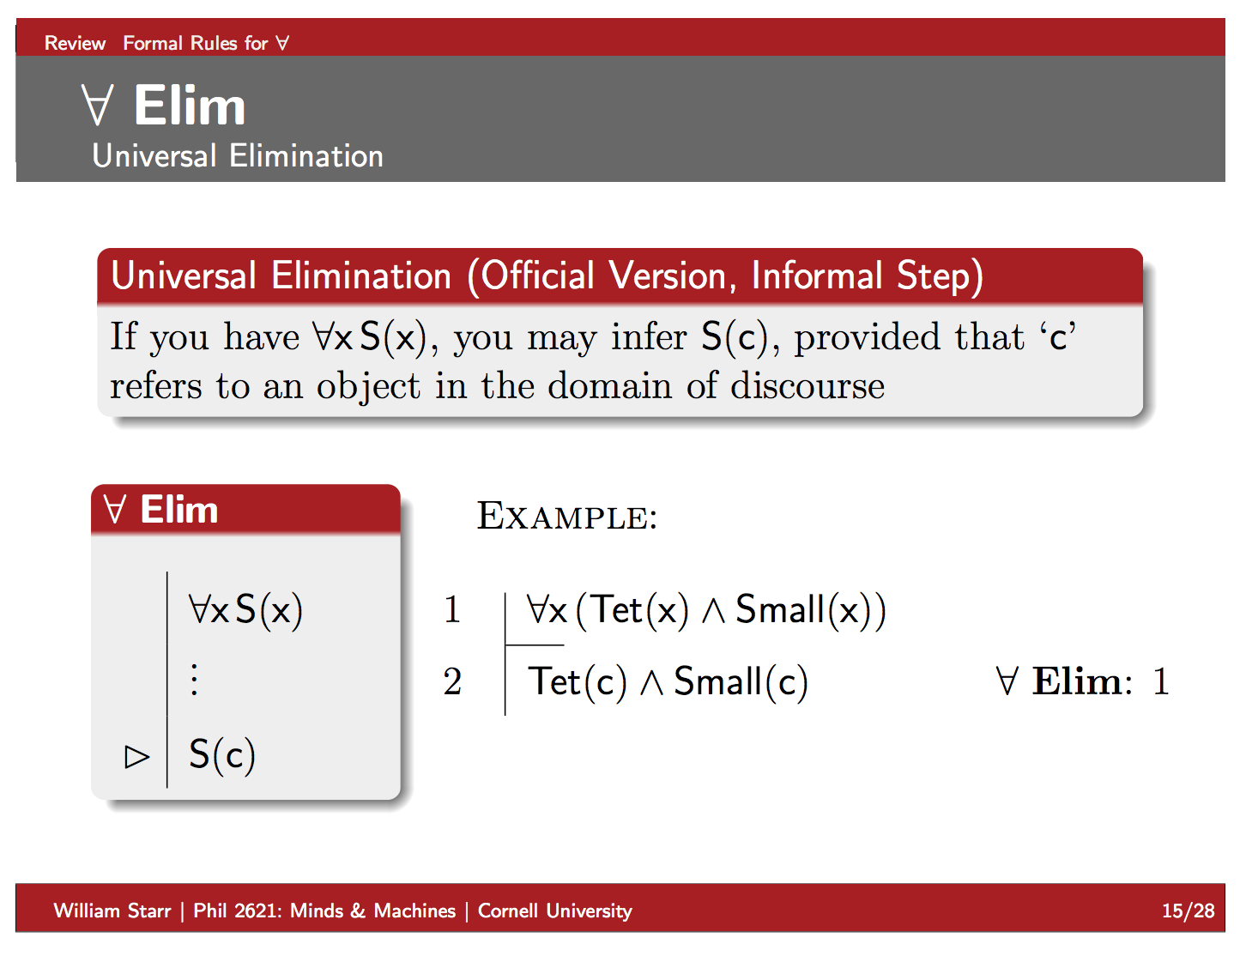

Slide 21
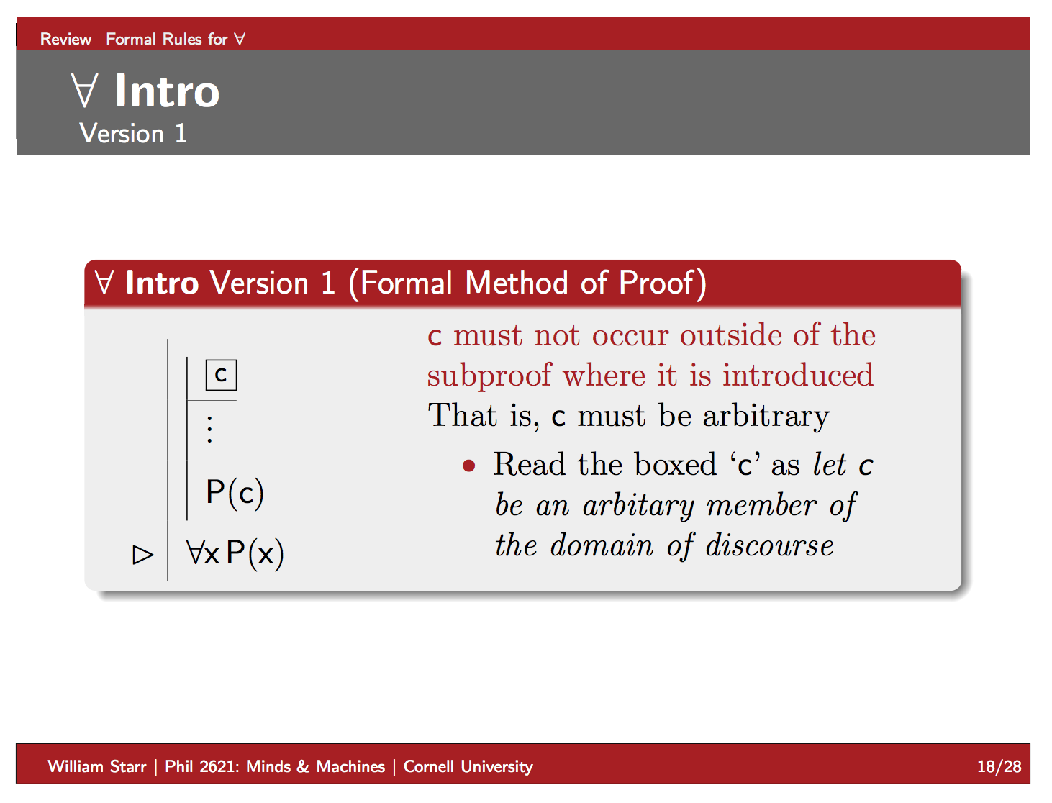

Slide 22
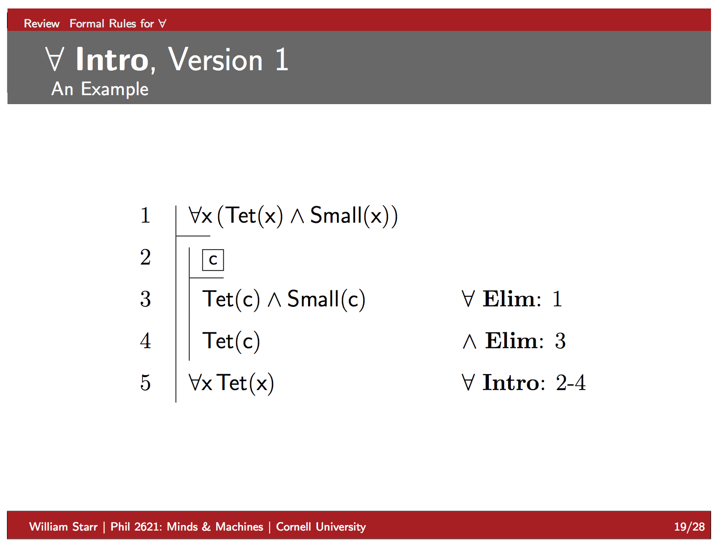

Slide 23
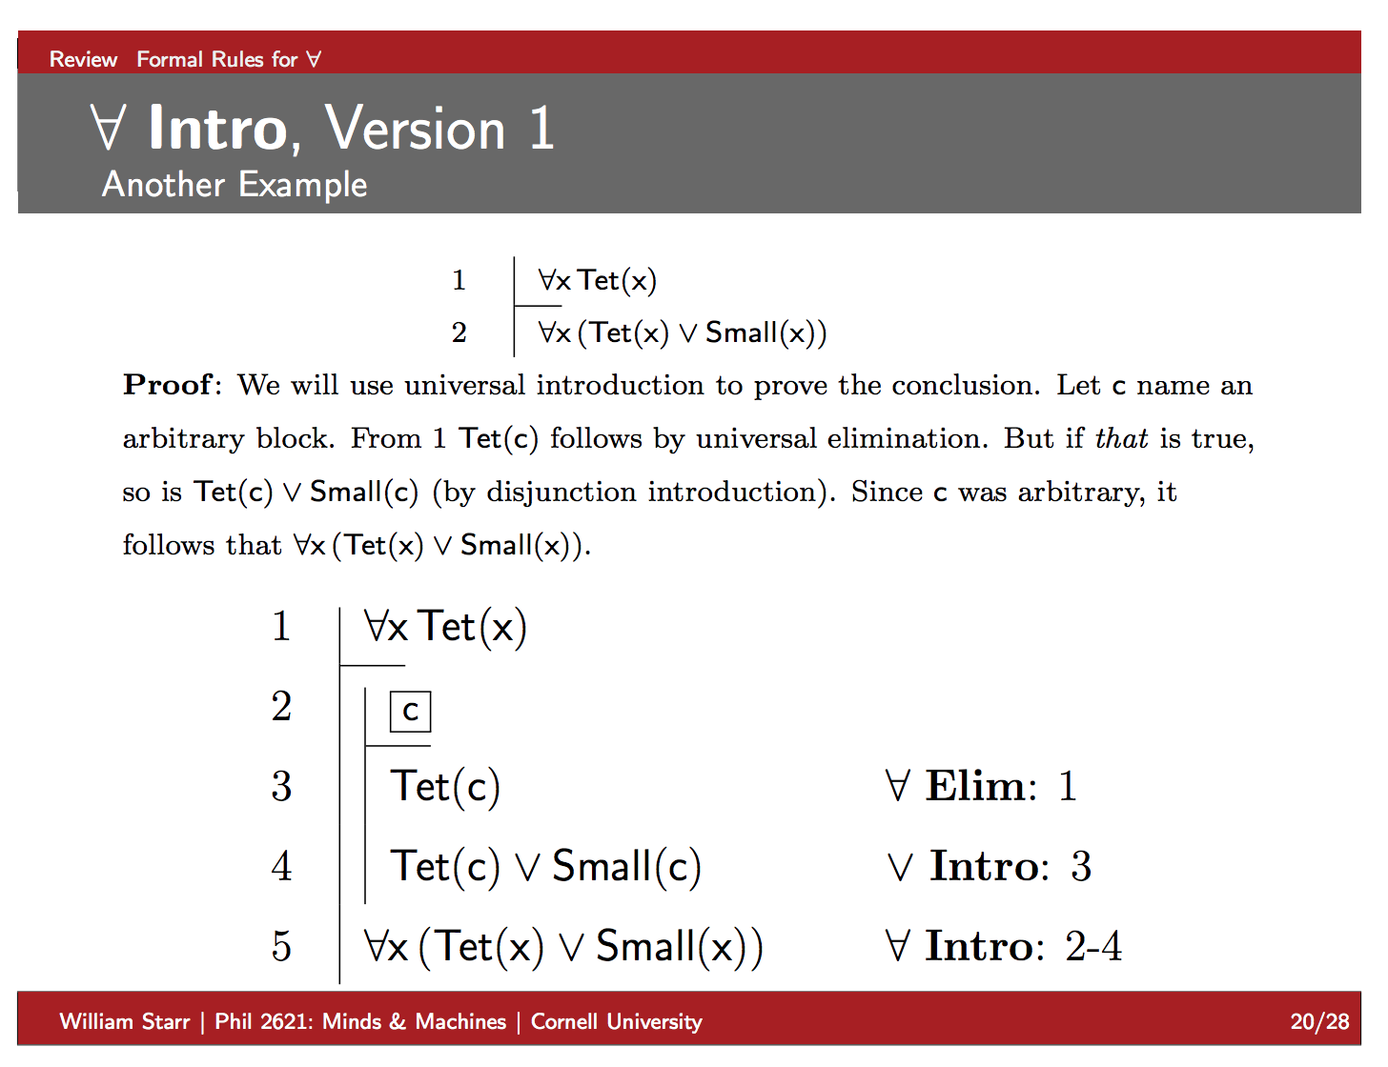

Slide 24
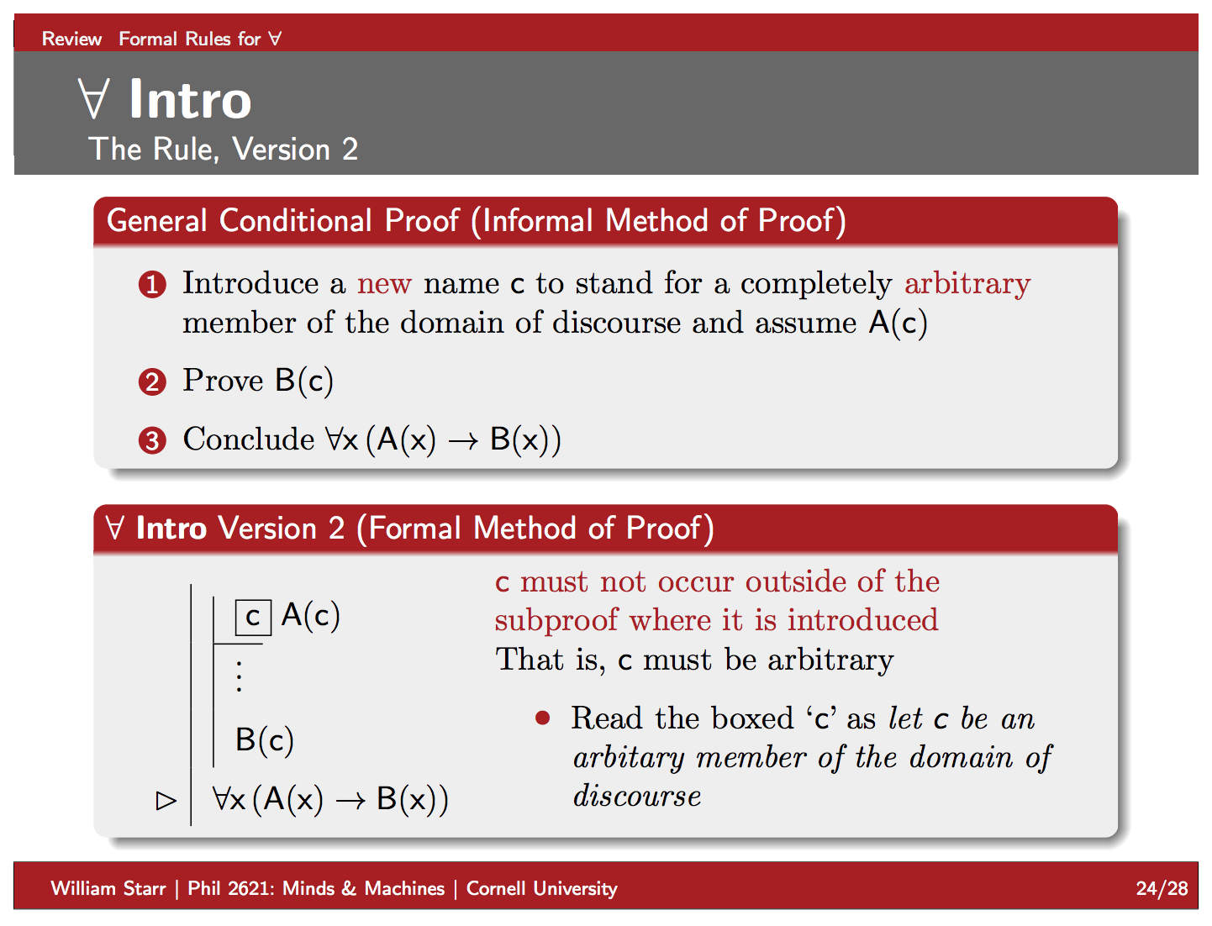

Slide 25
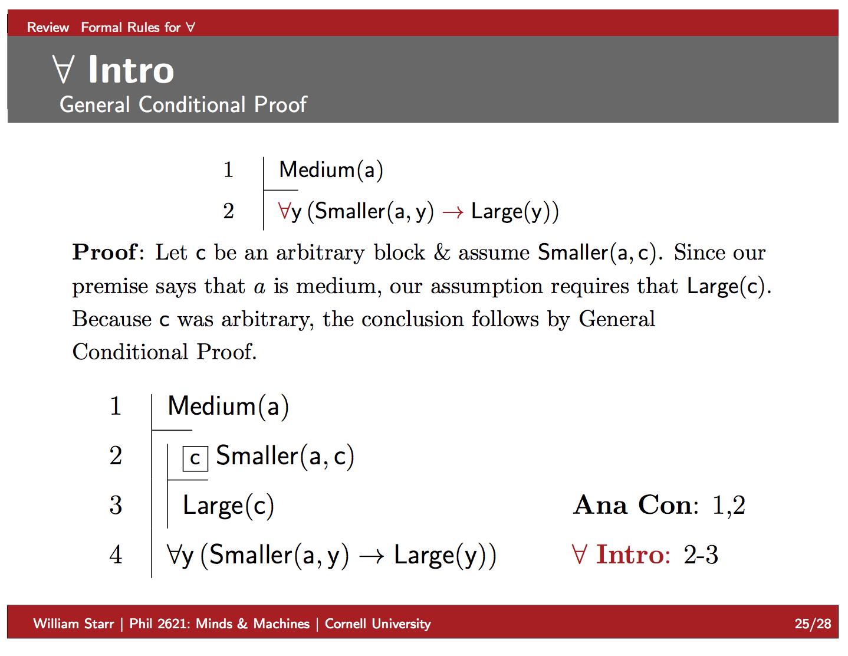

Slide 26
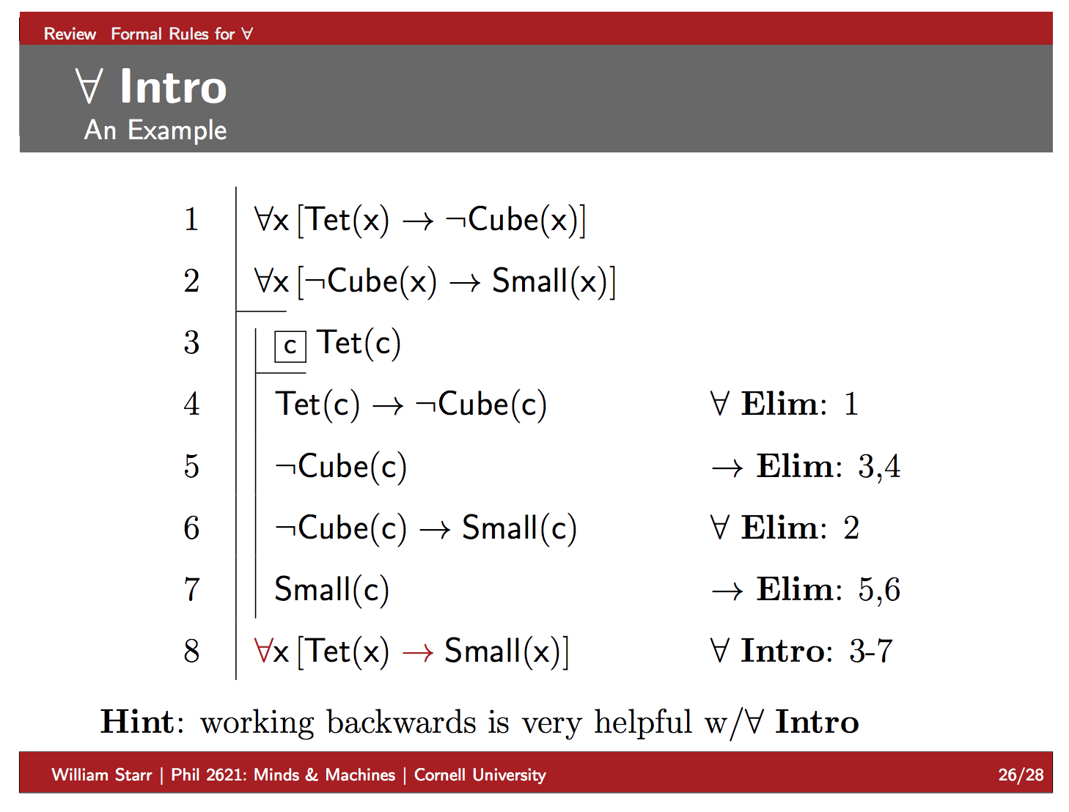

Slide 27
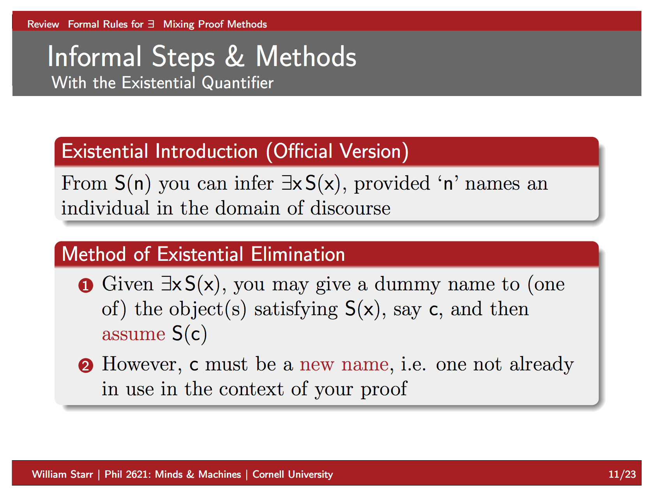

Slide 28
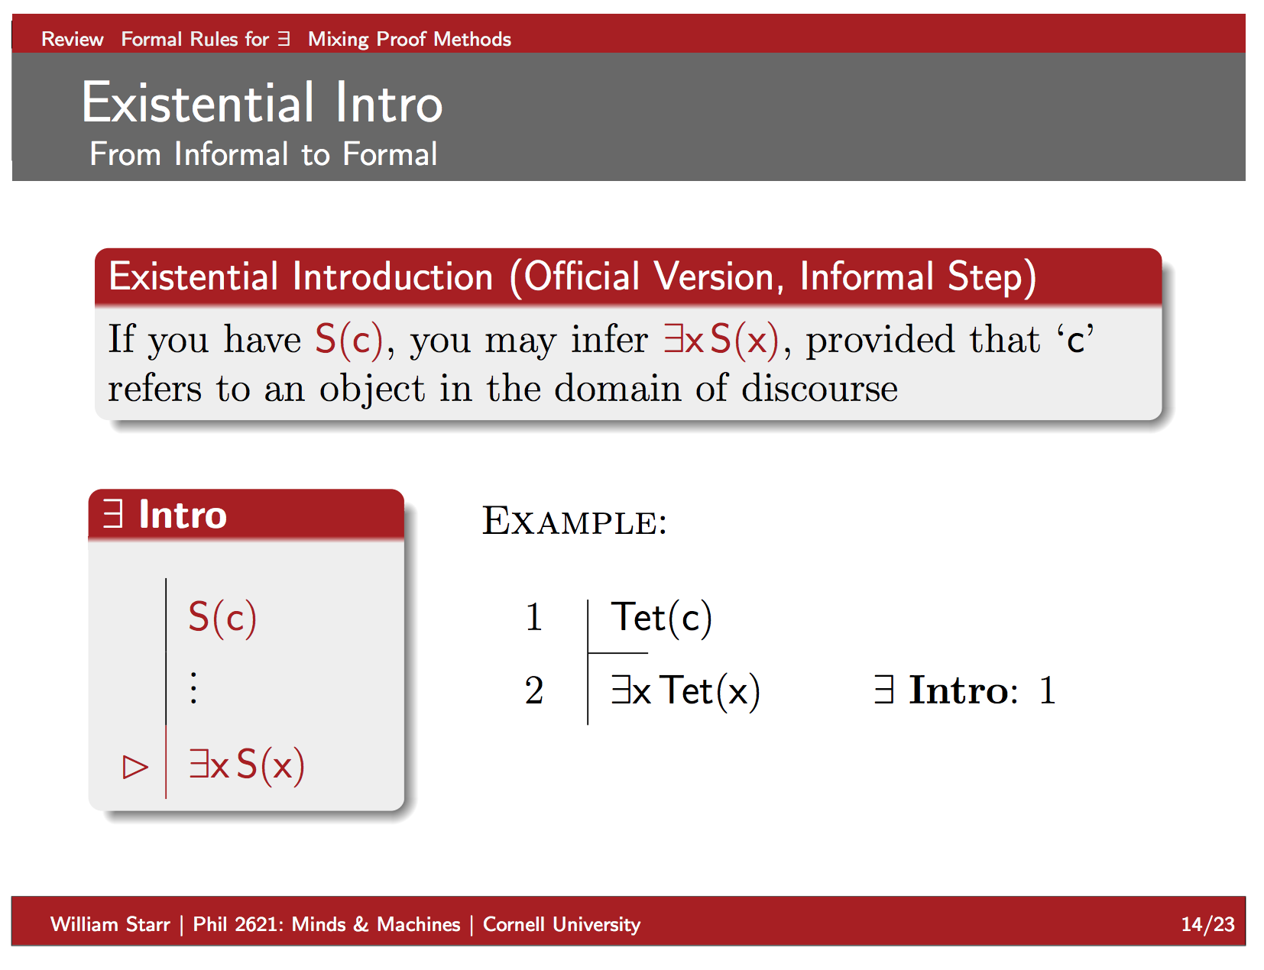

Slide 29
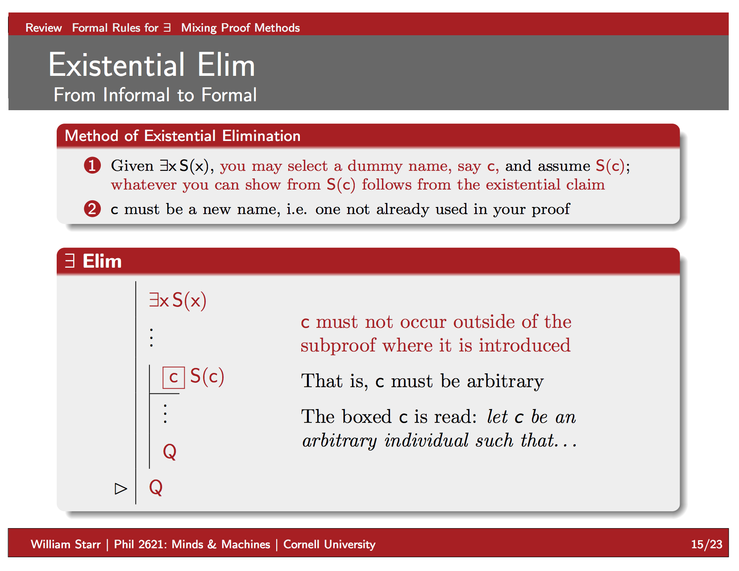

Slide 30
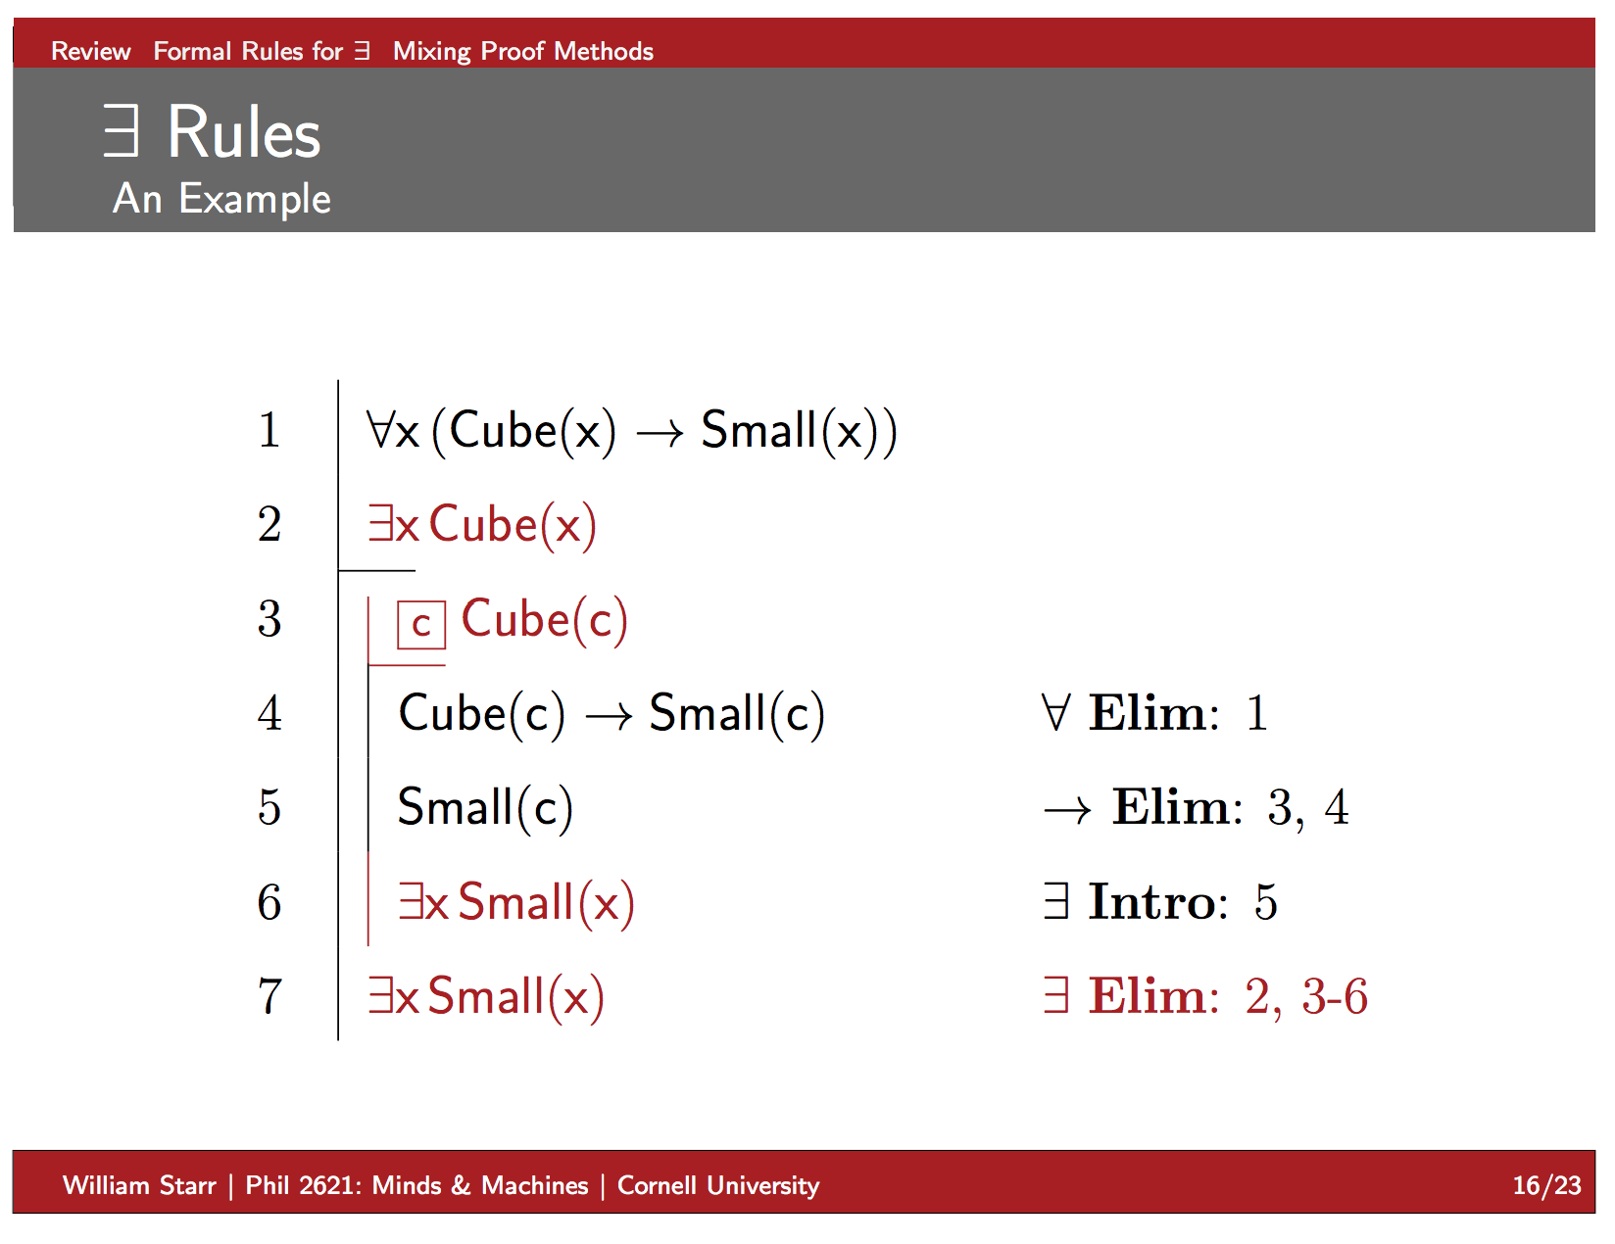

Slide 31
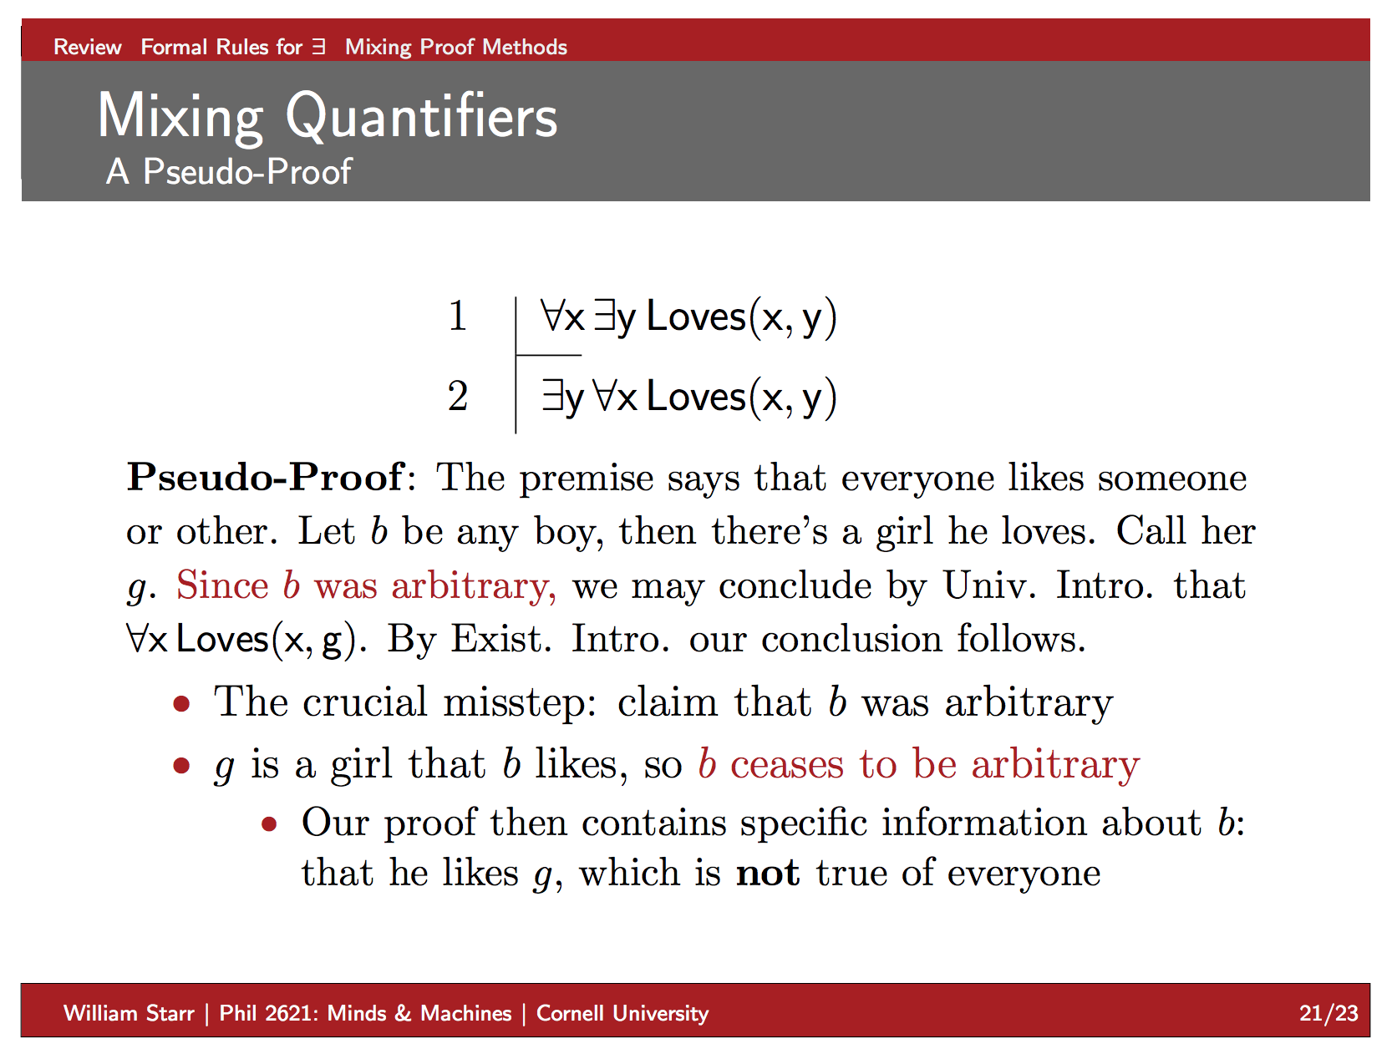

Slide 32
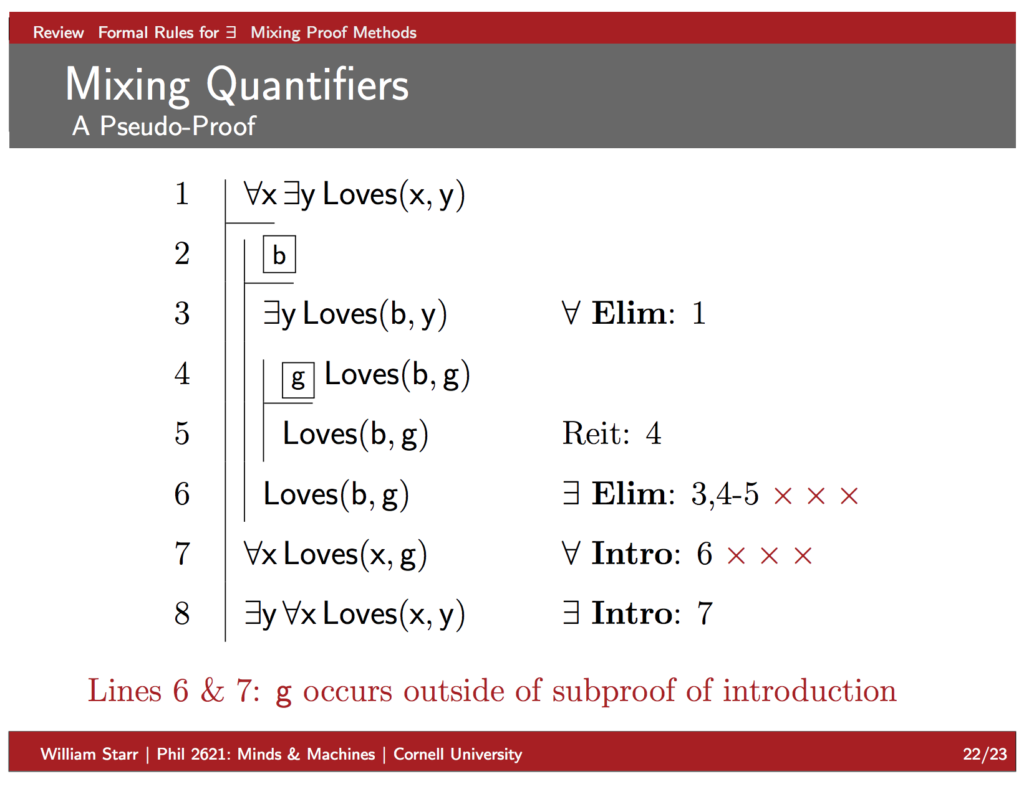

Slide 33
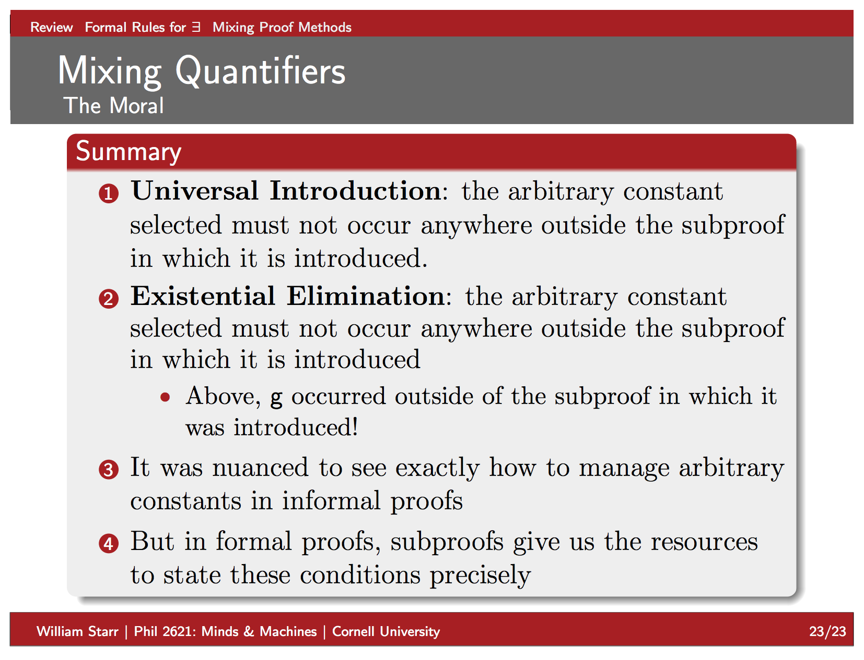

Slide 34
Examples
Prove the following:
Notes:
&\forall_x P(x) \vdash_F \neg \exists_x \neg P(x)\\
&\exists_x P(x) \vdash_F \neg \forall_x \neg P(x)\\
&\neg \exists_x P(x) \vdash_F \forall_x \neg P(x)\\
&\neg \forall_x P(x) \vdash_F \exists_x \neg P(x)

Slide 35
Vacuous truths
Consider the following. Is this always the case?
Why isn’t the following a contradiction?
For intuition, replace the above universal quantifiers with existential quantifiers

Slide 36
FOL Proofs as S-Expressions
Quantifiers can be expressions that take two arguments: a quantified variable (symbol), and a formula
(FORALL x (some formula))
(EXISTS x (some formula))
When we are creating temporary objects (as used in universal / existential elimination), we will use the symbols UCONST and ECONST, respectively:
(UCONST a)
(ECONST a (some formula containing a))
Use CONTR for ⊥. Note it is a 0-ary predicate!
Each line of a proof consists of an integer line index, a wff, and a justification:
(ind (formula) (justification))
The justification is a tuple consisting of a (possibly empty) list of line indices and an inference rule name

Slide 37
Inference Rule Names
S – supposition or assumption
CI, CE – ∧ intro / elim
DI, DE – ∨ intro / elim
II, IE – → intro / elim
NI, NE – ¬ intro / elim
AI, AE – ∀intro / elim
EI, EE – ∃intro / elim
XI, XE – ⊥intro / elim
UCONST, ECONST – Used for lines where we create temporary constants for universal / existential elimination

Slide 38
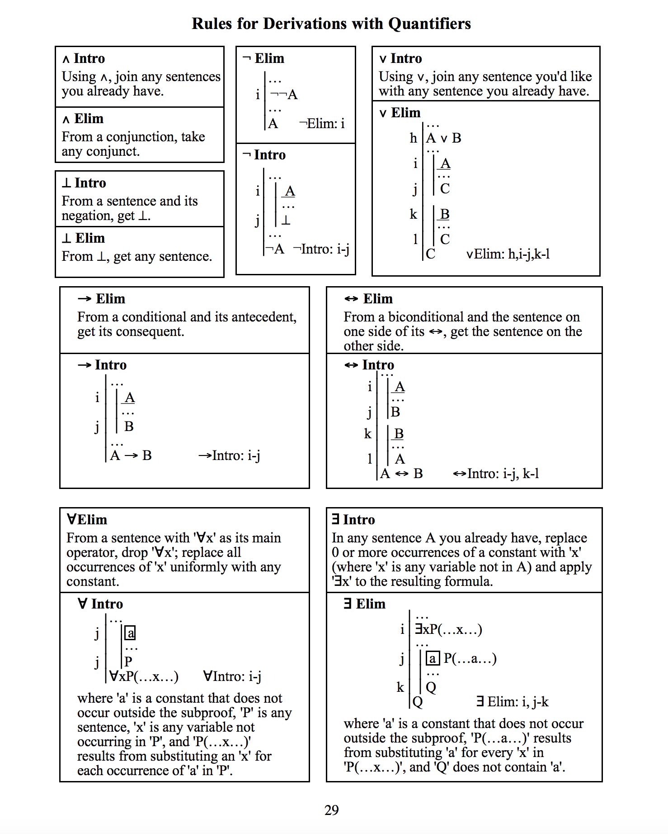
Use these forms of the rules for your assignments!
Source: http://www.csun.edu/~hcphi003/PHIL230/handbkLPL/H27-32.pdf

Slide 39
Why is this an incorrect application of existential elimination?
<<‘a’ is already a symbol in the proof!
Notes:
\fitchprf{
\pline[10.]{(\exists_x P(x)) \rightarrow Q(c)}[] \\
\pline[20.]{P(a)}[]
}{
\boxedsubproof[30.]{a}{P(a) \rightarrow Q(c)}{
\pline[40.]{Q(c)}[\life{20}{30}]
}
\pline[50.]{Q(c)}[\lexie{30--40}]
}

Slide 40
Subproofs
We will group a sequence of lines using SUBP.
The main (root) proof is simply treated as if it’s a subproof as well.
The second argument of a subproof is an index number. Be sure not to let them have the same index as a line.
Notes:
\fitchprf{
\pline[10.]{\forall_x P(x) \rightarrow Q(x)}[] \\
\pline[20.]{P(a)}[]
}{
\pline[30.]{P(x) \rightarrow Q(x)}[\lalle{10}] \\
\pline[40.]{Q(a)}[\life{20}{30}]
}

Slide 41
(SUBP 5 (10 (FORALL x (IMPLIES (P x) (Q x))) ([] S)) (20 (P a) ([] S)) (30 (IMPLIES (P a) (Q a)) ([10] AE)) (40 (Q a) ([20,30] IE)) )
Notes:
\fitchprf{
\pline[10.]{\forall_x P(x) \rightarrow Q(x)}[] \\
\pline[20.]{P(a)}[]
}{
\pline[30.]{P(a) \rightarrow Q(a)}[\lalle{10}] \\
\pline[40.]{Q(a)}[\life{20}{30}]
}

Slide 42
(SUBP 5 (10 (AND (NOT (P a)) (NOT (P b))) ([] S)) (SUBP 15 (20 (OR (P a) (P b)) ([] S))
(SUBP 25
(30 (P a) ([] S))
(40 (NOT (P a)) ([10] CE))
(50 (CONTR) ([30,40] XI))
)
(SUBP 55
(60 (P b) ([] S))
(70 (NOT (P b)) ([10] CE))
(80 (CONTR) ([60,70] XI))
)
(90 (CONTR) ([20,25,55] DE)) )
(100 (NOT (OR (P a) (P b))) ([15] NI)) )
Notes:
\fitchprf{
\pline[10.]{\neg P(a) \wedge \neg P(b)}[]
}{
\subproof{
\pline[20.]{P(a) \vee P(b)}[]
}{
\subproof{
\pline[30.]{P(a)}[]
}{
\pline[40.]{\neg P(a)}[\lande{10}]\\
\pline[50.]{\bot}[\lfalsei{30}{40}]
}
\subproof{
\pline[60.]{P(b)}[]
}{
\pline[70.]{\neg P(b)}[\lande{10}]\\
\pline[80.]{\bot}[\lfalsei{60}{70}]
}
\pline[90.]{\bot}[\lore{20}{30--50}{60--80}]
}
\pline[100.]{\neg (P(a) \vee P(b))}[\lfalsee{20--90}]
}

Slide 43
(SUBP 5 (10 (EXISTS x (P x)) ([] S)) (20 (FORALL x (IMPLIES (P x) (Q a))) ([] S)) (SUBP 25 (30 (ECONST b (P b)) ([10] ECONST)) (40 (IMPLIES (P b) (Q a)) ([20] AE))
(50 (Q a) ([30,40] IE)) ) (60 (Q a) ([25] EE)) )
Notes:
\fitchprf{
\pline[10.]{\exists_x P(x)}[] \\
\pline[20.]{\forall_x (P(x) \rightarrow Q(a))}[]
}{
\boxedsubproof[30.]{b}{P(b)}{
\pline[40.]{P(b) \rightarrow Q(a)}[\lalle{20}] \\
\pline[50.]{Q(a)}[\life{30}{40}]
}
\pline[60.]{Q(a)}[\lexie{30--50}]
}

Slide 44
(SUBP 5 (10 (FORALL x (IMPLIES (P x) (Q x))) ([] S)) (20 (FORALL x (P x)) ([] S)) (SUBP 25 (30 (UCONST a) ([] UCONST)) (40 (P a) ([20] AE)) (50 (IMPLIES (P a) (Q a)) ([10] AE)) (60 (Q a) ([40,50] IE)) ) (70 (FORALL x (Q x)) ([25] AI)) )
Notes:
\fitchprf{
\pline[10.]{\forall_x P(x) \rightarrow Q(x)}[] \\
\pline[20.]{\forall_x P(x)}[]
}{
\boxedsubproof[30.]{a}{}{
\pline[40.]{P(a)}[\lalle{20}] \\
\pline[50.]{P(a) \rightarrow Q(a)}[\lalle{10}] \\
\pline[60.]{Q(a)}[\lifi{40,50}]
}
\pline[70.]{\forall_x Q(x)}[\lalli{30--60}]
}

Slide 45
(Optional) To make your code more readable
Use LaTeX and the lplfitch library
https://ctan.org/pkg/lplfitch?lang=en
On MacOS, I like to use LaTeXiT to quickly generate proofs
The source code for Fitch-style proofs I created are on the notes of the slides
Might be helpful to write a converter from the S-expressions of proofs introduced here to LaTeX code

Slide 46
HW 2: Due Thursday, 10/4
You will write a Fitch-style proof verifier for FOL. This is an individual assignment; no groups.
Must work in Python 3.4+ without any special libraries (besides those that are in all default Python installations, e.g. sys, os, etc.)
Submit a file hw2.py with no outputting code (print or any similar statements) at any level. This file should have a function verifyProof(P), where:
P: A string which is an S-expression of a well-formed Fitch proof (see details on next slide). You can assume:
All operators (except for NOT) have two arguments (but see details on preceding slides)
All object and predicate symbols will be lower-case alphanumeric strings
All formulae and structures are well-formed proofs, using the notation from the previous few slides (UNDERGRADUATE STUDENTS ONLY)
Returns either a string or integer:
“E” – If the formula was not a well-formed FOL Fitch proof (GRADUATE STUDENTS ONLY).
“V” – If P is a well-formed FOL Fitch Proof, and the proof is valid, else
“I” – If P is a well-formed FOL Fitch Proof, but the proof is not valid.
A proof is valid only if:
It is well-formed,
All of its inference rules have been applied properly:
They are using the forms of inference rules listed in Slide 38 of this powerpoint
They have the right line numbers as premises
no references to future line numbers, e.g., line number 20 can’t cite line 30
Order doesn’t matter: if a line cites [20,30], it’s the same as if they cited [30,20]
All of its inferred formulas have been created properly.
Comment your code clearly
ANY issues harming automation may result in a grade of ‘0’. RIGOROUSLY TEST YOUR CODE.
All code written must be your own and not copied from elsewhere.
START EARLY. DO NOT UNDERESTIMATE THIS ASSIGNMENT.

Slide 47
HW 2: Due Thursday, 10/4
Suggested development plan:
[GRADUATE STUDENTS] Write function to verify wf-formulae, then wf-proofs
Write function to parse wf-proofs and wff into data structures you can work with
Write function that takes in antecedents and a consequent for a single inference rule, and verifies whether it is a valid application of that rule
Write function that takes in antecedents, consequent, and any inference rule name, and verifies whether that rule applies
Complete and polish your code

